Slide 1
Stock Value Prediction using Machine Learning
By Anitha Thanam

Slide 2
Machine Learning Model
Historical Data
Data Processing
Attribute Selection
Learning Algorithm (Learn Rules)
Learning Algorithm (Make Predictions)
Evaluate Results
Another Learning Algorithm
Training Data
Testing Data

Slide 3
This Project
Historical Stock Data
Data Processing
Attribute Selection Open,High,Low,
Close,Volume
SVM Algorithm (Learn Rules)
SVM Algorithm (Make Predictions)
Evaluate Results
SPO Algorithm
Training Data 2004 ~ 2014
Testing Data 2015

Slide 4
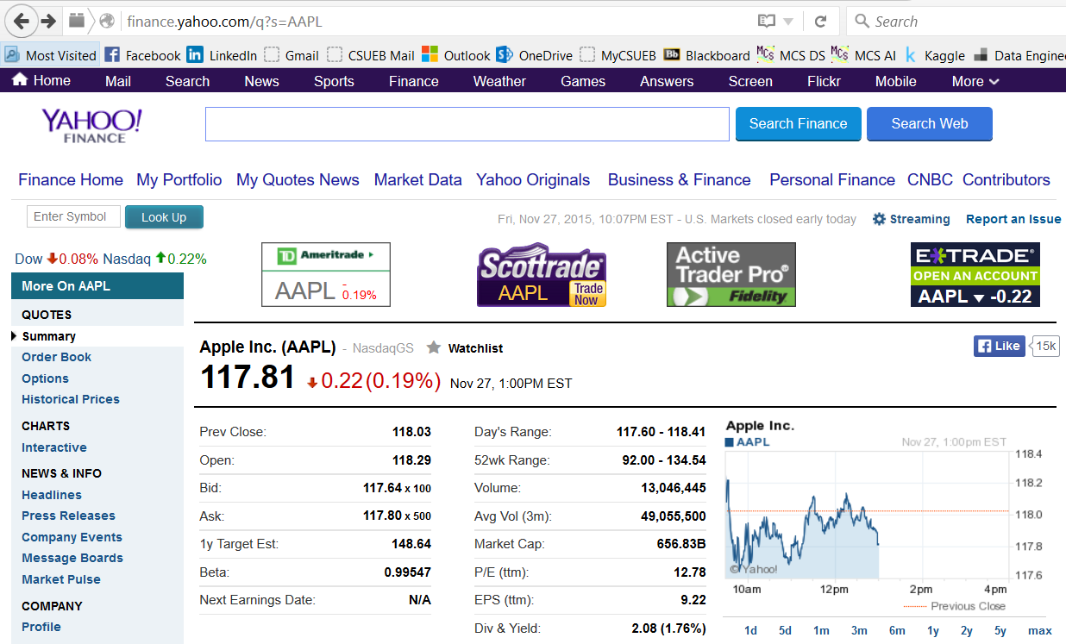

Slide 5
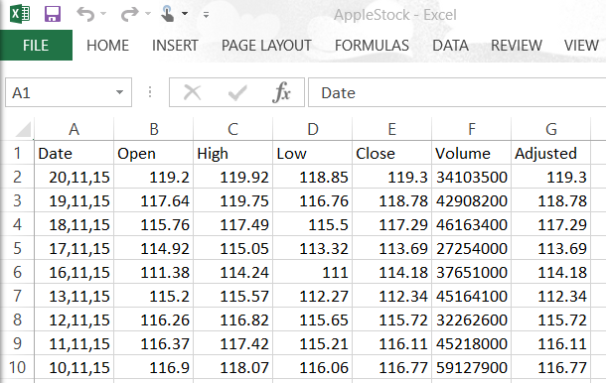

Slide 6
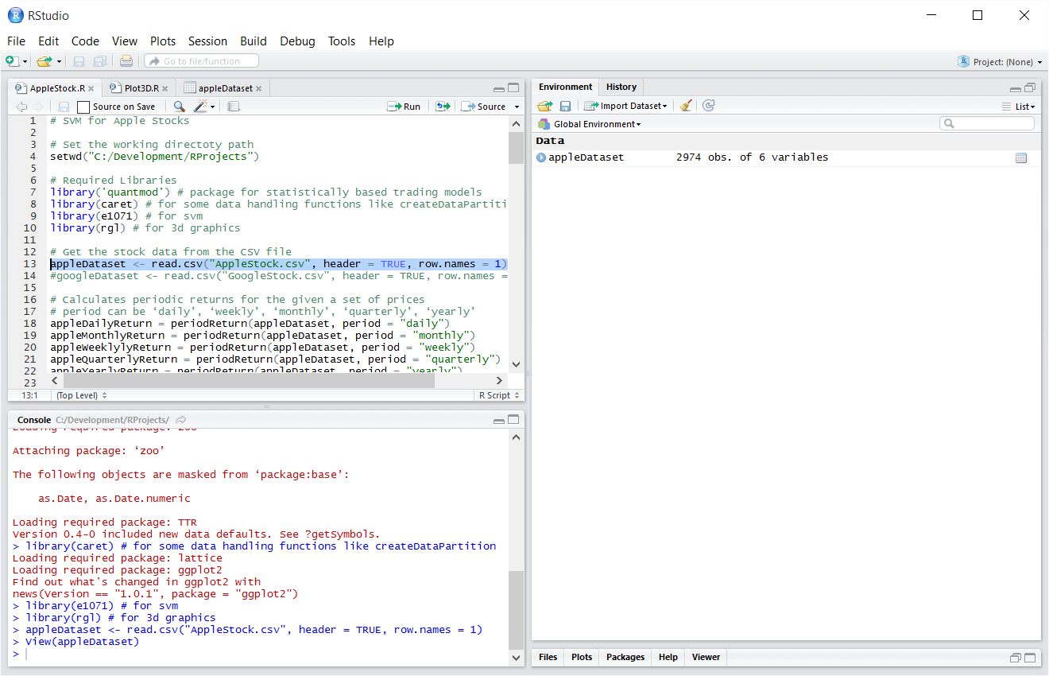

Slide 7
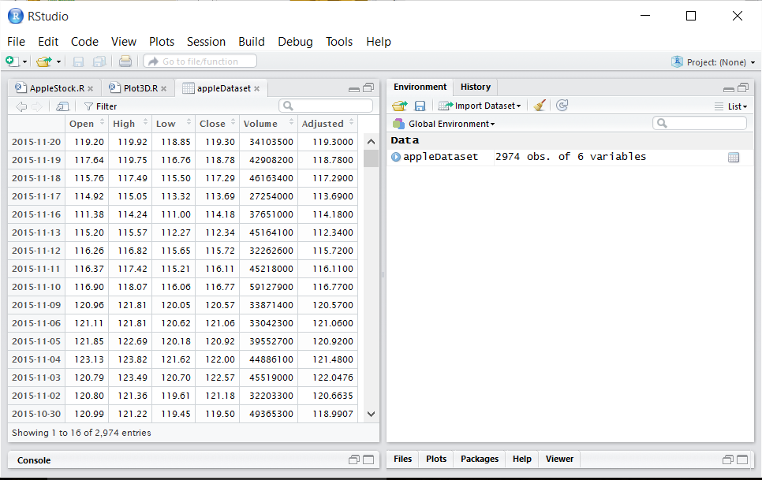

Slide 8
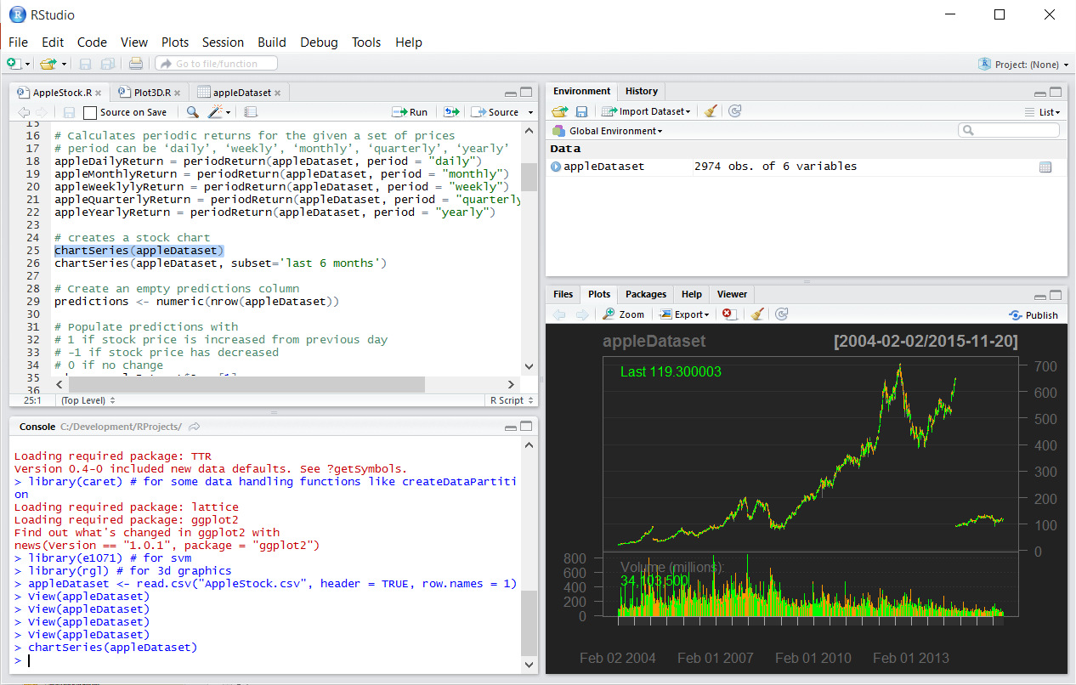

Slide 9
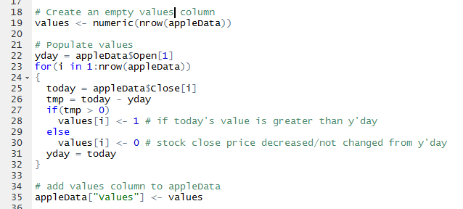
Creating values column for Learning Algorithm

Slide 10
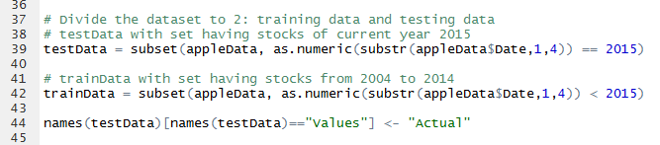
Populate Training and Testing data

Slide 11
Support Vector Machine (SVM)
Supervised learning algorithms
Used for classification and regression analysis
Basic SVM is a non-probabilistic binary linear classifier for linearly separable binary sets
Example
Plot the data set to a graph with 2 features mapped to x and y axis
Goal is to draw a line (or a hyperplane in 3D) that classify/separates the two classes of the data set

Slide 12
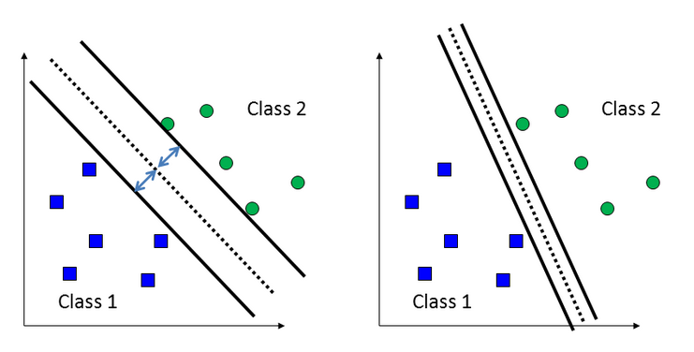
Max Margin Classifier Best choice is the one with large margin

Slide 13
Kernel Function
For non-linearly separable data
Maps from one input space (say 2D) into another richer feature space (say 3D) is called Kernel function/trick

Slide 14
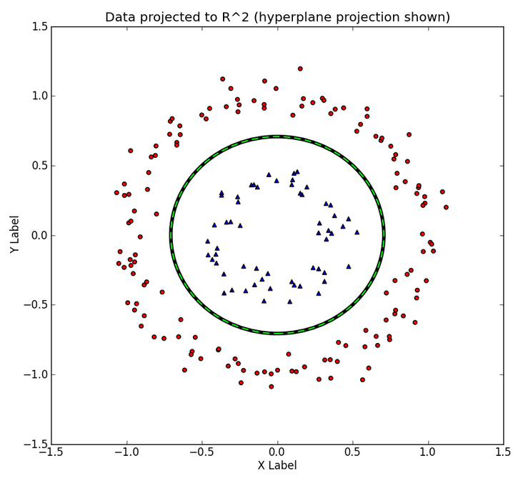
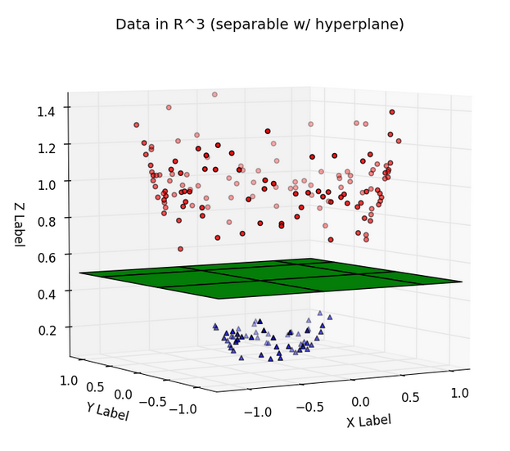
Example

Slide 15
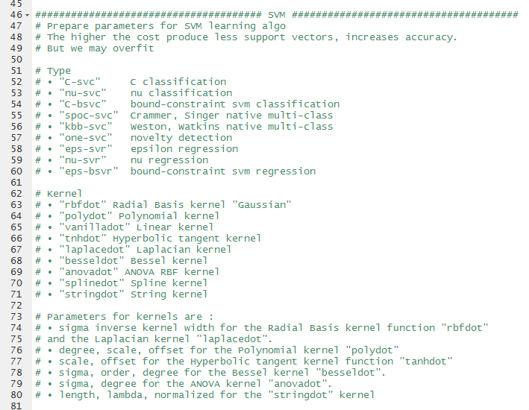
Title and Content Layout with Chart

Slide 16
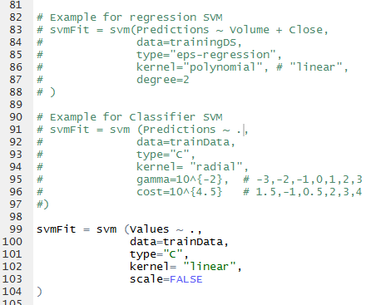
SVM API in R

Slide 17
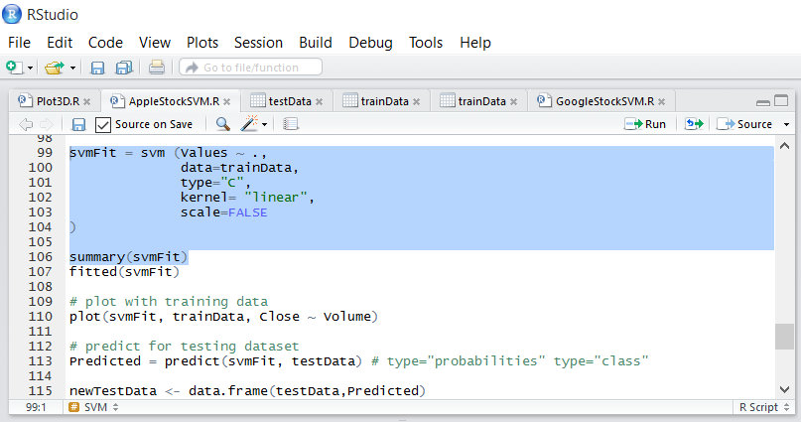
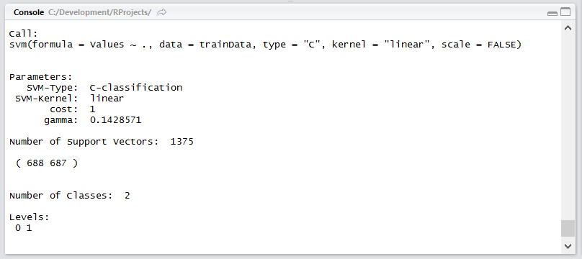

Slide 18
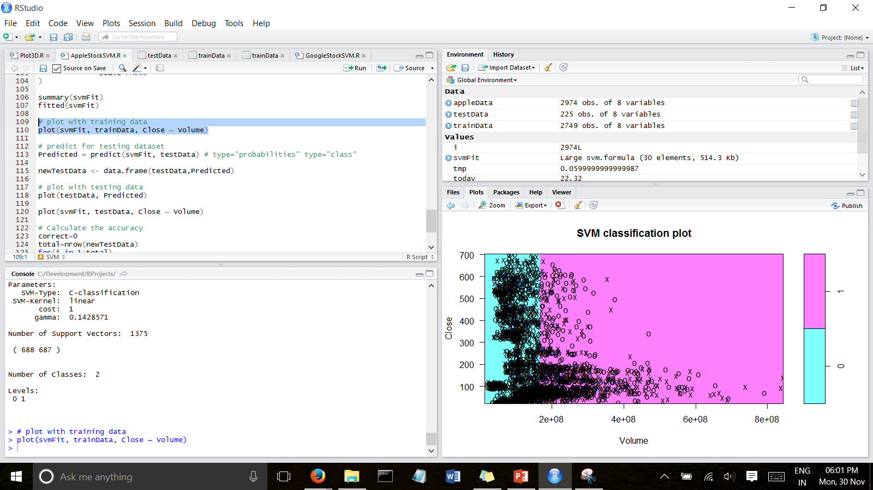

Slide 19
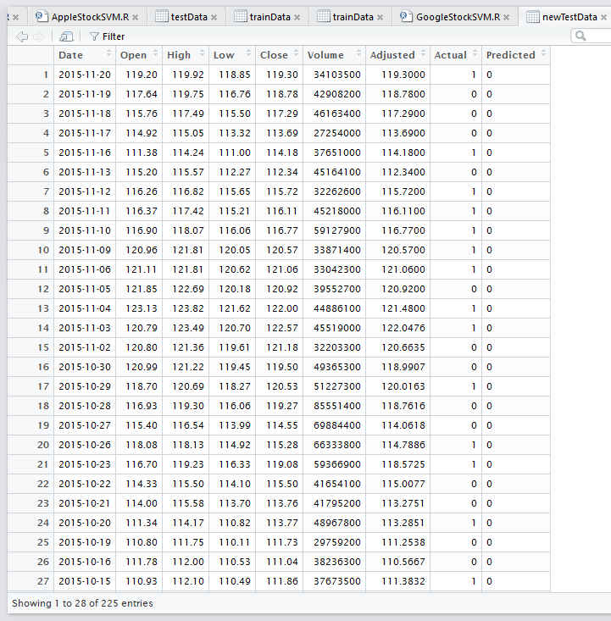

Slide 20
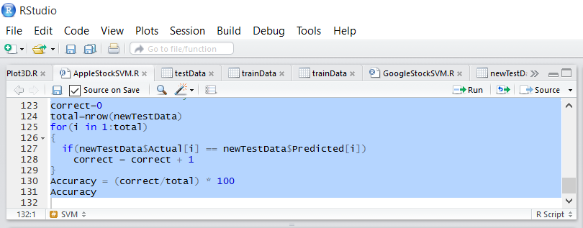
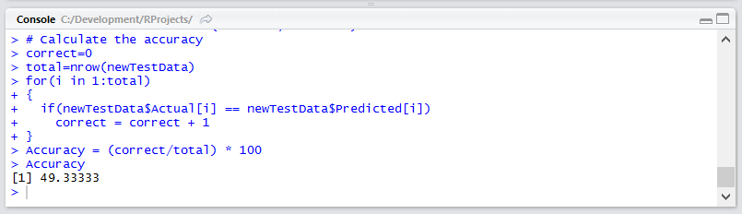

Slide 21
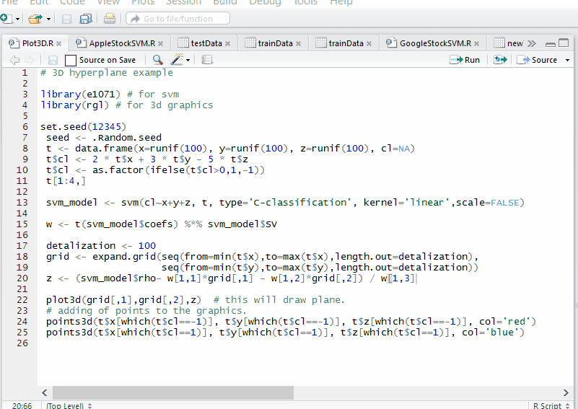

Slide 22
Questions???

